Slide 1
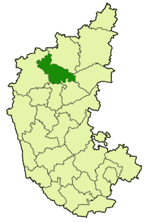
Project Proposal Presentation for DRIP Irrigation under
2nd Stage of Ramthal (Marol) LIS
Total area : 26200 Ha ( I & II Stage)
AREA: 12,571 Ha. – II Stage
Plus Addl. 11,429 Ha
Total 24,000 Ha – II stage
Hungund Taluk
Bagalkot District
Karnataka

Slide 2
ABOUT RAMTHAL (MAROL) LIS
Ramthal (Marol) LI Scheme is being implemented under Krishna Basin Projects to provide irrigation for 26,200 Hectare of drought prone areas of Hungund Taluka of Bagalkot District, utilizing 5.84 TMC of water.
Government had accorded administrative approval for the implementation of Ramthal (Marol) LIS under KBJNL at an estimated cost of Rs.218.00 Crores (PL of 2000-01).
The Scheme contemplates lifting of water in two stages from backwaters of Narayanpur reservoir.
(a) | 1st Stage near Marol in backwater of Narayanapur Dam | Lifting from RL 485.60 Mt. to 522.00 Mt. Command Area – 13,730 Hectare Head Work completed & Canal network completed. (conventional System)
(b) | 2nd Stage from West Canal near Ramwadgi | Lifting from RL 518.20 Mt. to 547.00 Mt. Command Area – 12,571 Hectare Head Work completed. Drip Irrigation proposed in lieu of Conventional Canal construction.

Slide 3
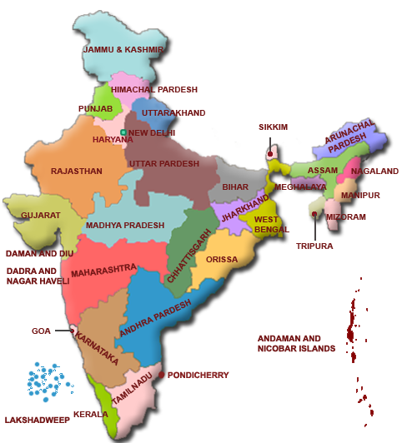
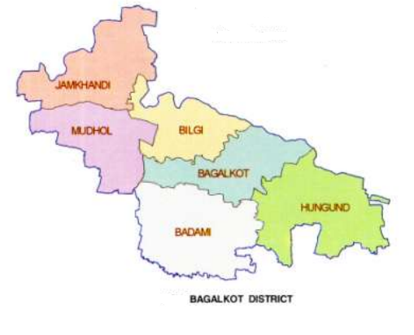
RAMTHAL(MORAL) LIS AT HUNGUND TQ. BAGALKOT DISTRICT
Project Area : Hungund Taluka, Bagalkot District.
Project Location : Latitude – 15º 48’ to 16º 34’ N
Longitude – 75º 12’ to 76º 21’ E
Total Command Area : I & II Stage: 26,200 Hectares
Proposed Drip for II Stage : 12,571 Hectares Plus Additional 11,429 Hectares
Total Area : 24,000 Hectares under Drip.
KARNATAKA

Slide 4
Water utilization under Drip with different Cropping Intensity
AREA in Hectare | Water Available in TMC | Cropping Intensity % | Utilization of water in TMC | Water Savings in TMC
12,571 | 2.77 | 115 | 1.43 | 1.34
 |  | 170 | 2.77 | 0
24,000 |  | 115 | 2.77 | 0
Notes:
4

Slide 5
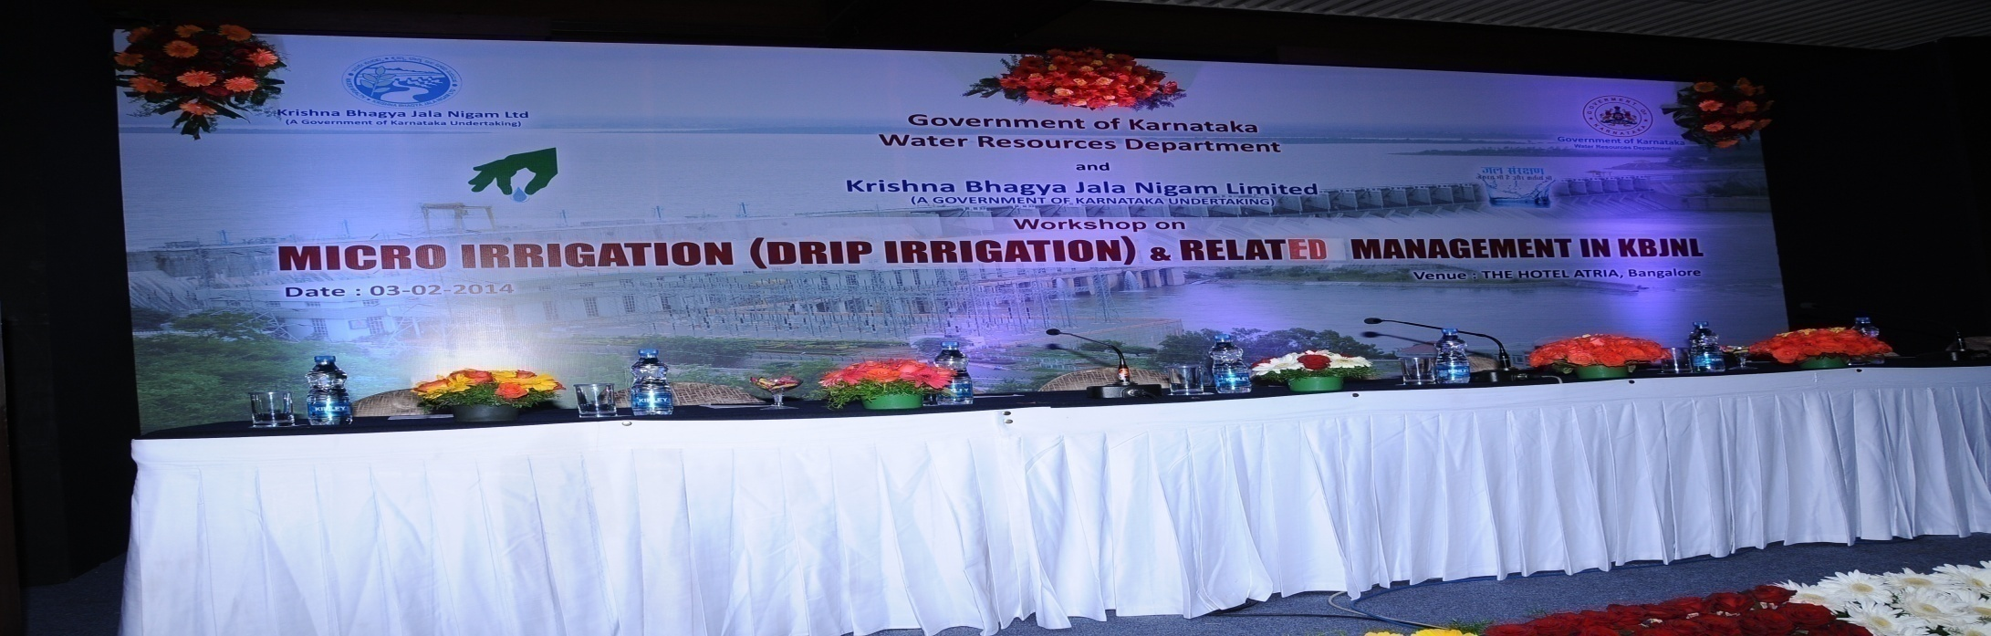
Request
As this is a Pilot Drip Irrigation System at large scale for first time in Karnataka in India, therefore, funding is requested from Government of India.
APPROVALS
Government vide G.O dt 16-08-2012 has accorded administrative approval for implementation of Micro-irrigation system as a pilot project under 2nd stage of Ramthal( Marol) LIS including O&M for Rs 786.11 crores ( PL 2011-12

Slide 6
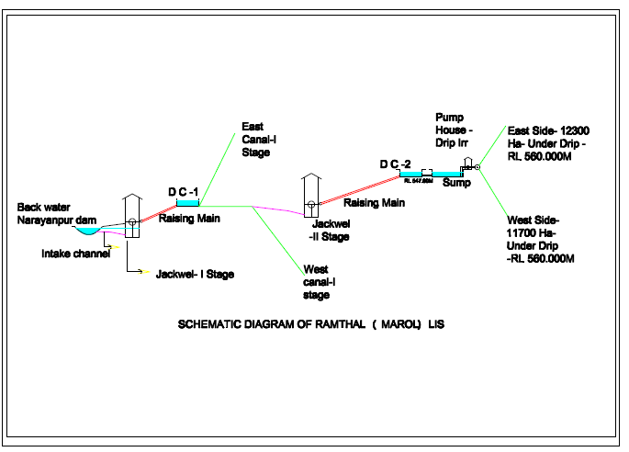
Brief Technical Details of the proposed Drip irrigation
In the present proposal of Drip Irrigation, the irrigation intensity and cropping pattern considered are at 115%. The contemplated ICA under CONVENTIONAL Irrigation in 2nd stage of Ramthal LIS was 12,571 Hectares and the water availiability is 2.77 TMC.
Adoption of Drip irrigation lead to a savings of water of about 1.34 TMC and by retainingm the approved cropping intensity of 115%, dditional area of 11,429 Hectares (upto RL 560 Mt. including additional command of Hungund Taluk) is proposed for irrigation through drip.
The total area of 24,000 Hectares is divided into 48 blocks and each block is having an approximate area of 500 to 600 Ha. Further, each block is designed in multiple module of 50 Ha. zones and there will be totally 840 zones. Each 50 zone is provided with one head unit and drip irrigation system with fertigation equipment, mains, sub-mains and control valves and drip lines with integral drippers.
The lateral spacing considered is 1.52m with dipper spacing 0.40 m.

Slide 7
SCHEMTAIC DIAGRAM OF RAMTHAL (MAROL) I STAGE LIS & II STAGE DRIP IRRIGATION
I STAGE GRAVITY FLOW – 14050 Ha
II STAGE DRIP IRR – 24000 Ha
DRIP NET WORK EAST SIDE AREA-12300 HA- 4 Zones z
NARAYAN PUR DAM BACK WATER
I STAGE EAST MAIN CANAL-5960 Ha
INTAKE CHANNEL 475 m
RAISIING MAIN 4.65
D C
D C
SUMP
RAISING MAIN 3.01
334m
JACKWELL / PUMP HOUSE
II STAGE JACK WELL
DRIP PUMP HOUSE
DRIP NET WORK WEST SIDE AREA-11700 HA – 2 Zones
I STAGE
WEST MAIN CANAL-8090 Ha

Slide 8
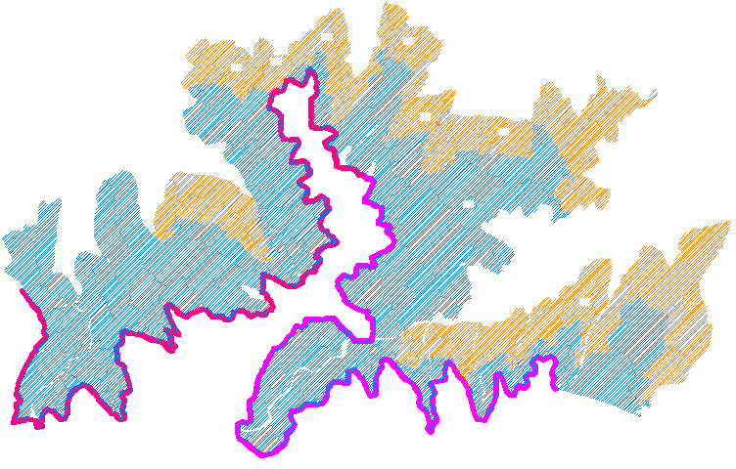
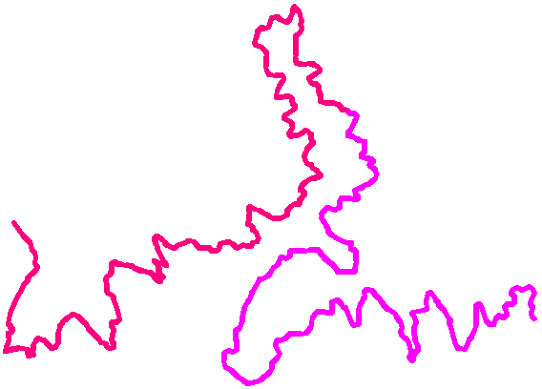
Krishna River
Option 4 : Low Head Pump Drip Irrigation area from Pipeline network for 24,000 Hectare
1st Stage Pumping
1st Stage Main canal
1st Stage RM
1st Stage DC
2nd Stage RM
2nd Stage Pumping
1st Stage Main canal
2nd Stage DC
Mainline Network
Additional Area (11,429 Ha.)
8

Slide 9
ABSTRACT OF COST ESTIMATE
Sl. No | Component | Estimated Cost (Rs. In Lakhs)
1 | Preliminaries : Detailed Engg, preparation of design, drawings, survey investigation, topographical survey for additional command etc. | 472.00
2 | Construction : a) Electro-mechanical works - Pumping Mach. & electrical works including construction of 33 KV Sub-station and lying of 33 KV power line. b) Civil Works - Construction of feeder pipe network (HDPE), sump, pump house, store rooms (50 Nos.) rtc. c) Filtration system – Auto filters with water meter computerized d) Drip irrigation system – Construction of main feeder pipe network, other civil works (PVC / HDPE), irrigation controller, emitting manifolds, etc. | 1299.91 15079.00 399.23 53008.50
3 | Maintenance - 5 years of operation and maintenance including supply of spares & tools and agronomic services in project area for 10 seasons | 1140.11
4 | Electrical Supply – ESCOM Deposits | 10.00
5 | Land Acquisition | 1400.00
 | Total | 76408.74
 | Add 3% Contingency & rounding off | 2203.00
 | GRAND TOTAL | 78611.30

Slide 10
Field Design Objectives
The micro-irrigation systems fulfill the following objectives of:
Higher water use efficiency
Energy Efficiency
Higher crop productivity for every drop of water
Savings in labor
Savings in fertilizers
Faster returns on investment
Use of LPS technology minimizes the use of electricity for operation of the micro-irrigation system at the farmers’ field.
Notes:
10

Slide 11
Project scenario after adoption of Drip Irrigation System
As construction of Distributary canals and Field canals are eliminated therefore project execution can be completed in shorter time.
Land acquisition is minimized because of pipe network resulting in project cost saving.
This also increases the conveyance efficiency of water which is around 60% to 70% in canal system to almost 85 % in a pipe network system.
Efficient use of precious water.
Around 12,571 Hectares as well as additional 11,429 Hectares area can be brought under Drip irrigation
As Drip Irrigation System can feed with available local source of water cropping intensity can be increased.
Least maintenance of pipe network as compared to canals.
Even water distribution – better yield and quality of produce.
With Drip Irrigation an area of 24,000 Hectares can be irrigated with the available 2.77 TMC
11

Slide 12
Project aim
The aim of the Project is :-
To increase the irrigable area from 12,571 to 24,000 Hectares
To increase the yield of the crop by 30% to 80%
To increase the Overall water & fertilizer use efficiency from 50% to 85%
To use minimum Power.
To improve the socio economic conditions of the beneficiaries.
Notes:
12

Slide 13
AGRI - LINKAGES
KBJNL is also considering developing downstream linkage with Agri-processing firms for better price realization for farmers.
A study in this regard was initiated with IFC for identifying potential private partners.

Slide 14
Salient features of project
A. Name of Project | Ramthal Lift Irrigation Scheme
B. Location | Marol Village, Hungund Taluka, Bagalkot District Latitude 16° 10’ to 16°15’N Longitutde 76°05’ to 76° 10’E
C. Name of River | Krishna river (from back water of Narayanpur Reservoir)
D. Purpose | Irrigation ( by Lift)
E. Means of Access | By road the Project is about 20 Kms from NH 13.
F. Temperature | Minimum 15.2 ° C Maximum 41° C
G. Submergence area | NIL as water is being lifted.
H. Technical details
i) Source | Water is lifted from back waters of Narayanpur Reservoir, near Marol village of Hungund taluka in Bagalkot Dsitrict.
ii) Full reservoir level of the Narayanpur Dam ( FRL) | L 492.256 M
iii) Minimum draw down level of Narayanpur Dam (FRL) | RL 485.60 M
iv) Gross storage | TMC 37.64
v) River bed level at Marol village : | 479.256 M
vi.) Water utilization under scheme | 4.5+1.34 = 5.84 TMC
vii.) Total command area served | 26200 Ha
viii.) Number of Lift stages | 2 stages 1st Lift near Marol from Narayanpur reservoir. 2nd Lift from First Lift West Main canal a Km 8.867.

Slide 15
First stage Intake
II stage Jackwell
II stage VT Pumps
I stage Jack well
I stage West Canal
II Stage DC
I stage VT Pumps
I Stage DC
Drip Sump & JW

Slide 16
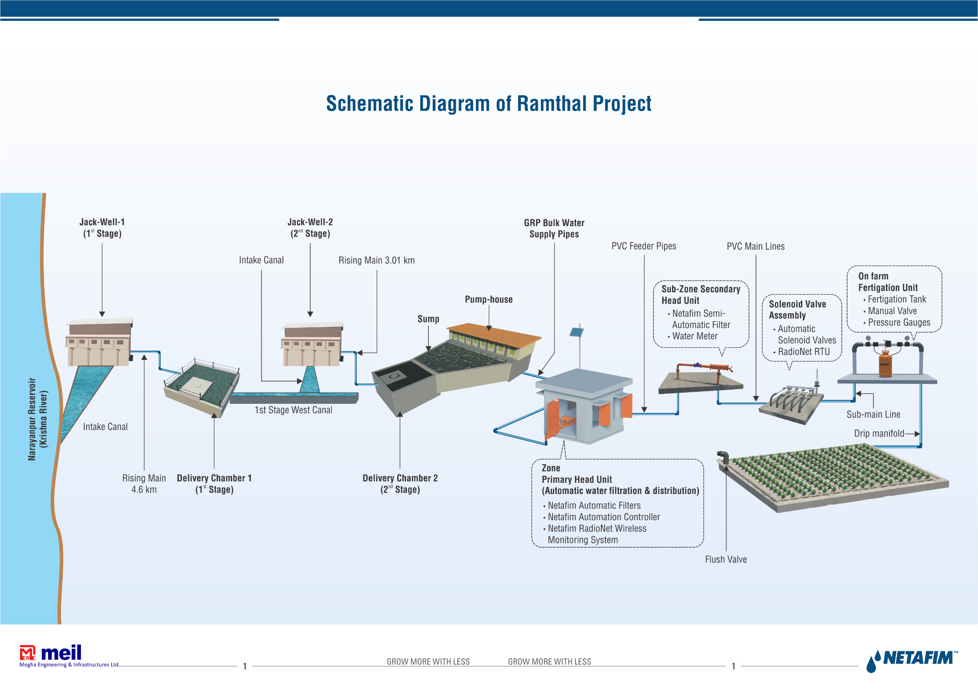

Slide 17
LAYOUT – SUMP, PUMP HOUSE , PUMPS AND SUBSTATION MEIL(JV)
SUMP
SUB STATION
PUMP HOUSE
4 +1 STAND
BY PUMPS
4 +1 STAND
BY PUMPS
MANIFOLD
CENTRIFUGAL PUMPS
BULK WATER SUPPLY PIPE
LOW PRESSURE ZONE
BULK WATER SUPPLY PIPE
HIGH PRESSURE ZONE

Slide 18
Pump & Filter Layout Jain Irrigation Ltd
Zone - I with 2 Working Pump + 1 standby Pump and All 3 pumps will be operated under VFD
Zone - II with 2 Working Pump + 1 standby Pump and All 3 pumps will be operated under VFD
Zone - III with 2 Working Pump + 1 standby Pump and All 3 pumps will be operated under VFD
Zone - IV with 2 Working Pump + 1 standby Pump and All 3 pumps will be operated under VFD
Motorized B.V
Flow Transmitter
Primary Filter
Pressure Transmitter
Pumps

Slide 19
Zone
500 Ha
23 Zones
Sub-Zone
50 Ha
230 Sub-zones
Blocks
5 Ha
2300 Farmer blocks
15
14
16
13
17
1
12
3
18
1
21
2
19
23
20
5
8
9
6
High Pressure Network
Low Pressure Network
500Ha Zone Outlet
Delivery Chamber
22
10
11
7

Slide 20
Bulk Water Supply (BWS)
15
14
16
13
17
1
12
3
18
23
21
4
2
19
5
20
8
9
6
High Pressure Network
Low Pressure Network
500Ha Zone Outlet
Delivery Chamber
22
11
10
7

Slide 21
FARMER LIST AND SOCIO-ECONOMIC SURVEY :
All the Zone wise farmers list are prepared. Each individual farmers are counseled, opinion obtained. All farmers agreed to cooperate with the suggested agronomy. The soil samples of the entire area are tested for issue of Soil Health Cards and Socio-Economic survey is completed.
2. FORMATION, REGISTRATION OF WUCS & CAPACITY BUILDING OF FARMERS:
The total area- 24,000 Ha. Total No. of WUCS Proposed – 50 (15,180 Farmers) All the 50 WUCS proposals are registered. 50 Societies registered and the election for chief promoters is Completed on 31st Dec 2015 and 3rd Jan 2016. The bye law for drip irrigation is modified & approved and included in the WUCS bye laws.

Slide 22
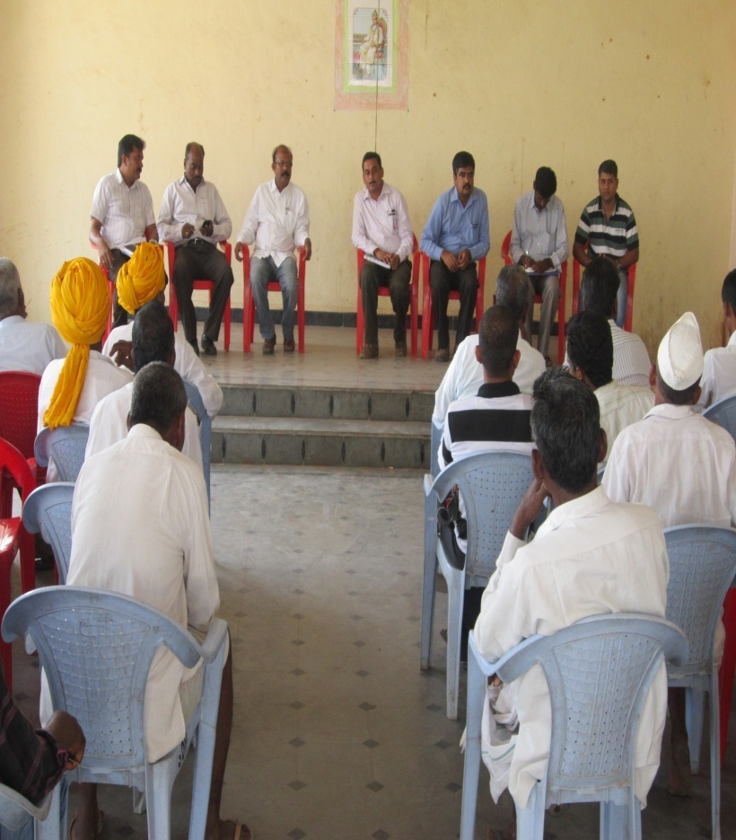
Socio economic survey Farmers meeting
Class room training On Demo Farms
Socio economic sample survey conducted -500 farmers data collected.
296 farmers meeting done
90 % of the beneficiaries are met with and motivated on drip adoption.
5450 beneficiaries visited demo farms apart from other farmers.
Farmers in batches are brought to drip plots and trainings conducted.
Demo vans are deployed to beneficiary villages and demonstrations conducted.
Land Holding Graph

Slide 23
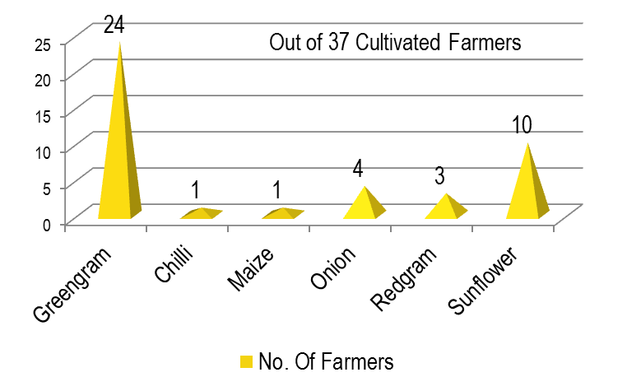
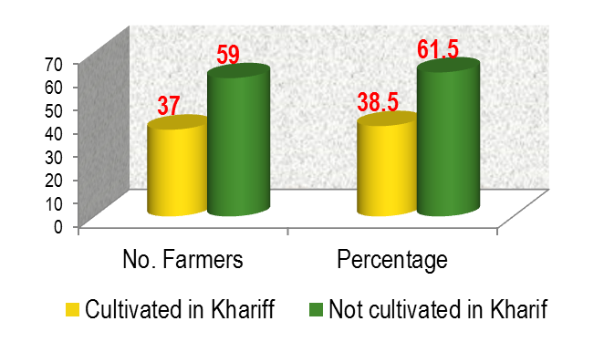
3. Finalization of Crops
AS PER SURVEY
Some farmers grow more than one crop
Planned Kharif Crops:
Crop Grouping | Planned crops
Crop needing up less than 2.4 mm / day | Vegetable such as Cabbage and Beans
Crop needing up to 2.4mm/ day PWR | Ground nut, Cotton, Cowpea, Sunflower, Greengram, Blackgram, Green Chilies, Maize, Babycorn,
Crop needing above 2.4 to 3.00 mm/day PWR | Beans, Dill, Coriander, Spinach, Methi, Amaranthus Cucumber, Gherkin, Sweet Potato, Custer Beans, Field Beans, Ridgeguard, Bitterguard Soybean, Sesamum, Tomato, Bhendi, Melon, Cauliflowerr, Carrot, Radish, Beetroot

Slide 24
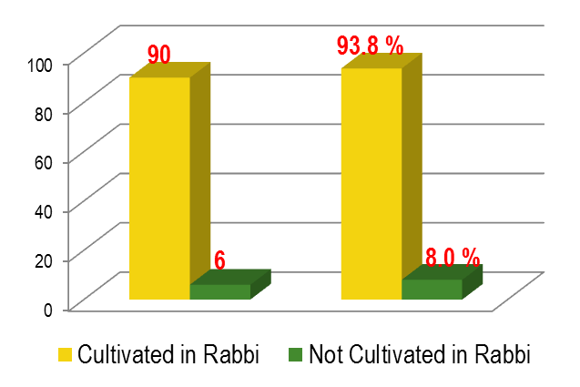
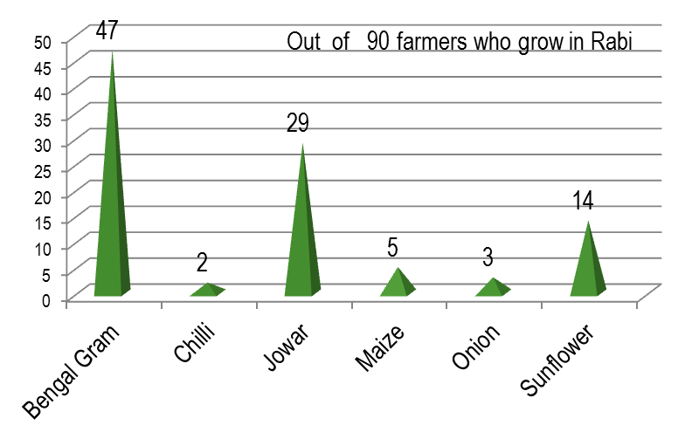
AS PER SURVEY
Planned Rabbi Crops:
Some farmers grow more than one crop
Crop Grouping | Planned crops
Crop needing less than 4.00 mm / Day | No Crops available
Crop needing up to 4.00 mm/day PWR | Jawar, Bajara, Barley, Groundnut, Sunflower, Soybean, Cotton, Safflower, Garlic, Gharkin, Cabbage, Beans, Dill, Coriander, Spinach, Methi, Amaranthus, Greenpeas.
Crop needing above 4.00 to 5.00 mm/day PWR | Chillies, Bhendi, Maize, Cauliflower, Carrot, Beetroot, Sweet Potato, Cluster beans, Field beans, Ridgeguard, Bitterguard, Sunflower, Onion, Babycorn, Cucumber, Wheat, Oats, Melon, Radish, Niger, Bengalgram

Slide 25
FOR KHARIFF SEASON
Designed Application Rate | Crop Grouping | Application of Water (mm/day) | Application % of Water | Extent of Area Coverage | Deficit Irrigation (%) | Water volume (TMC) (Water allotted=0.44TMC) | Remarks
2.40mm | Crop needing less than 2.4mm/day PWR | 2.4 mm | 100% Water Application | 100 % Area | 0 % | 0.44 | Being Vegetable Cannot be considered for entire area
2.40mm | Crop needing up to 2.4mm/day PWR | 2.4mm | 100% Water Application | 80% Area | 0% | 0.44 | Recommended as high yield is assured.
2.40mm | Crop needing up to 2.4mm/day PWR | 1.92mm | 80% Water Application | 100% Area | 20% | 0.44 | 20 % deficit irrg results in substantial reduction in crop yield . Research papers appended
2.40mm | Crop needing above 2.4 to 3.00 mm/day PWR | 2.4mm | 80% Water Application | 80% Area | 20% | 0.44 | 20 % deficit irrg results in substantial reduction in crop yield, but area cannot > than 80%. . Research papers available.
2.40mm | Crop needing above 2.4 to 3.00 mm/day PWR | 2.1mm | 70% Water Application | 91% Area | 30% | 0.44 | 30% deficit irrigation is not supported by any research studies so far.
2.40mm | Crop needing above 2.4 to 3.00 mm/day PWR | 1.92mm | 64% Water Application | 100% Area | 36% | 0.44 | 30% deficit irrigation is not supported by any research studies so far

Slide 26
For Rabbi Season:
Designed Application Rate | Crop Grouping | Application of Water (mm/day) | Application of Water (mm/day) | Extent of Area Coverage | Deficit Irrigation (%) | Water volume (TMC) (Water allotted=0.83TMC) | Remarks
4.00 mm | Crops needing Less than 4.00 mm PWR |  | 100& of water application |  |  | 0.83 | Crops les than 4.00 mm is a question of survival in the project terrain.
4.00 mm | Crops needing up to 4.00 mm PWR | 4.00 mm | 100 % of water Application | 50 % area | 0% | 0.83 | Recommended as high yield is assured
4.00 mm | Crops needing up to 4.00 mm PWR | 3.20 mm | 80 % of water Application | 62 % area | 20% | 0.83 | 20 % deficit irrg results in substantial reduction in crop yield .with operational difficulties. Research papers available
4.00 mm | Crops needing up to 4.00 mm PWR | 2.00 mm | 50 % of water Application | 100% area | 50% | 0.83 | 50% deficit irrigation is not supported by any research studies so far
4.00 mm | Crops needing up to 4.00 mm PWR | 4.00 mm | 100 % of water Application | 100% area | 0% | 1.31 | The allocated water is 0.83 TMC. The required water is 1.31 TMC, but the discharge available at the head is only 6 cumecs with 24 hours pumping.. Designs needs modification.

Slide 27
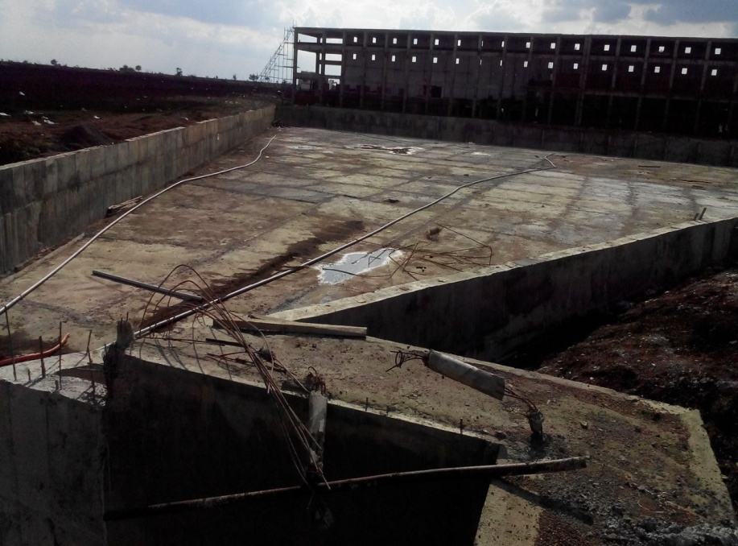
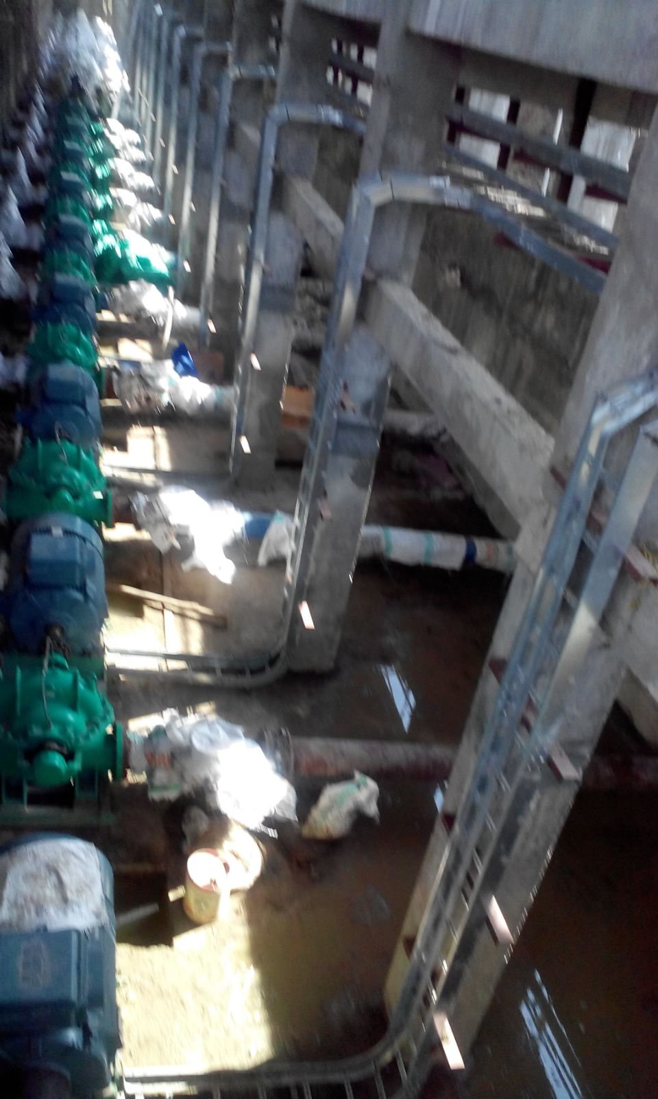
Stage of the Project
The Work is Awarded in two Packages West Side area and East Side area
West side area : 11700 Ha- Meil -Netafim JV . Rs 381 Cr
Pump house / Sump work under progress
The company has completed the Laying of Bulk water supply pipe line to a length of 47.95 Kms out of 48Kms. laying the Mains & sub main works under progress is completed
The Sump well and Pump house concreting is completed.
Power sanction obtained sub station work is completed and transmission line is under progress from the dedicated 110KV line existing at 1.90 Km.( 6 Towers completed out of 9)
Cabling work completed and Bus Duct installation is under progress.
Totally 23 numbers of WUCS formed ,
Demo farms were created and crops like Gerkin, Maize, Sunflower and Onion harvested and found increase in yield compared to conventional irrigation.
Demo farms with Brinjal, Chillies, Wheat and Cotton were harvested.
Wheat, Marigold flower water melon is under progress
The Scheme will be commissioned within 10th Feb 2015.

Slide 28
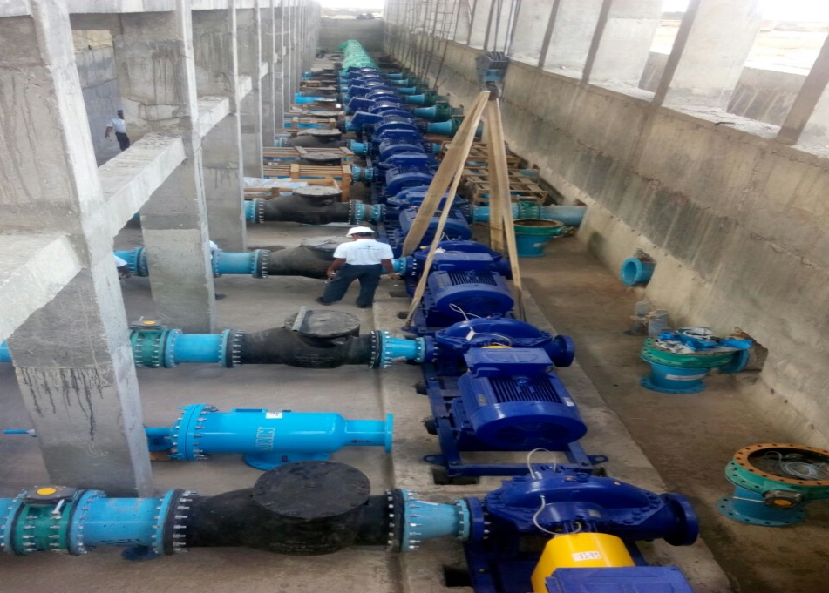
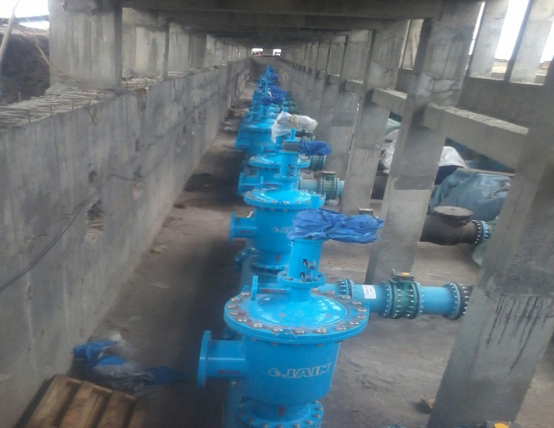
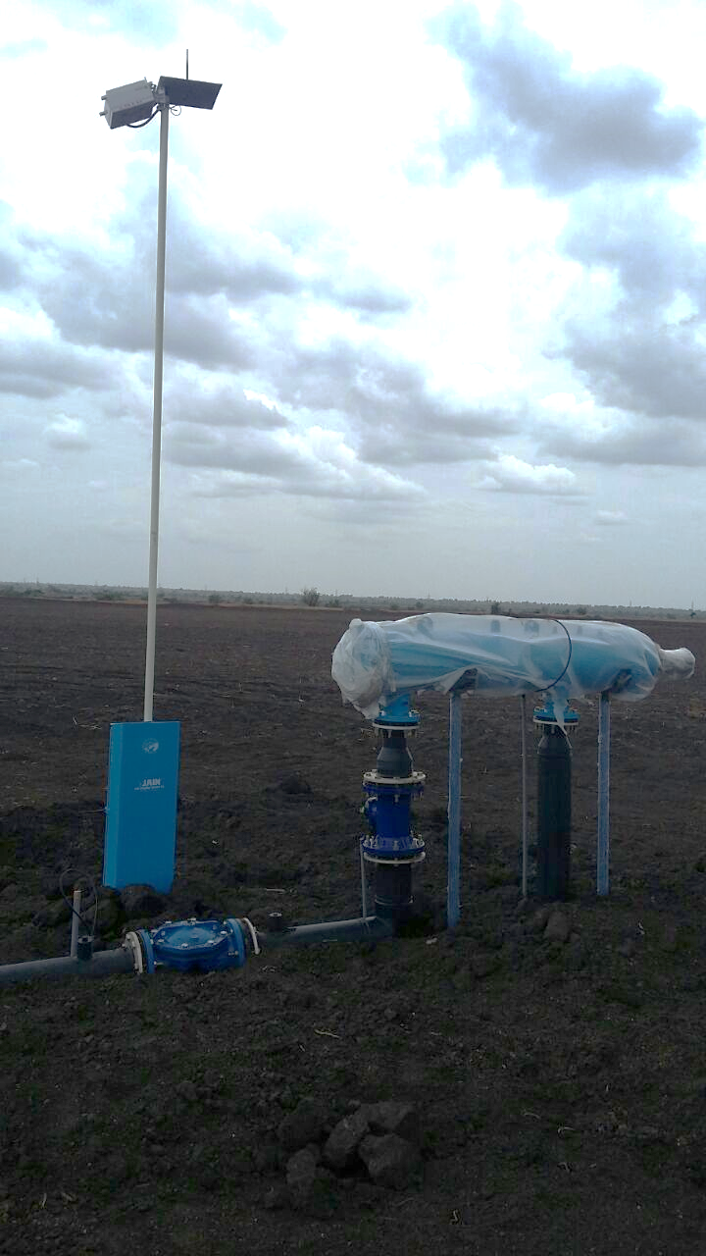
East Side area- 12300 ha
East side area : 12300 Ha- Jain Irrigation. Rs 385.7 Cr
The company has completed the Laying of Bulk water supply pipe line to a length of 90.30 Kms and are laying the Mains and sub main pipes
Procurement of pipes and laterals completed. Mains and sub-main pipes are completed
All the pumps are installed, Manifold for three zones completed.
Totally 28 numbers of WUCS formed , Election for Chief Promoter and Promoters Completed and modified by law included in the WUCS.
Demo farms were created and crops like Sunflower , Safflower , Maize, wheat , Chillies, Brinjal harvested.
Deom farms with Wheat, french beans, red gram Bajra Marigold sugar cane Jowar, Brinjal under progress
The Scheme is ready for commissioning
FILTERS

Slide 29
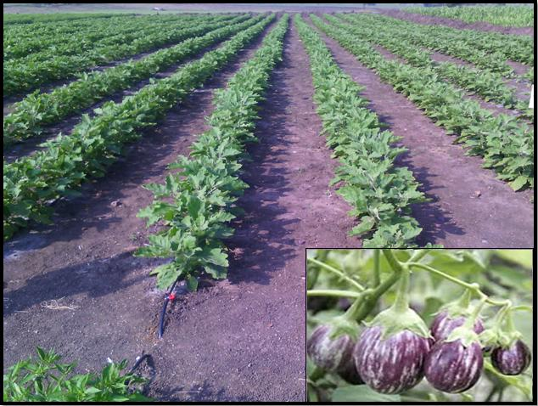
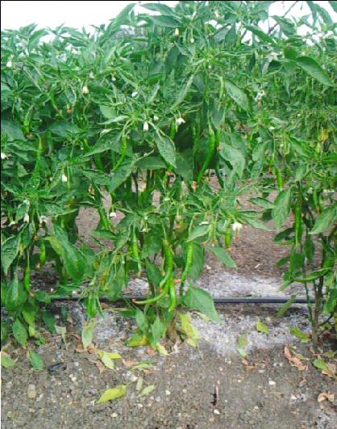
BRINJAL – Ramvadagi CHILLIE

Slide 30
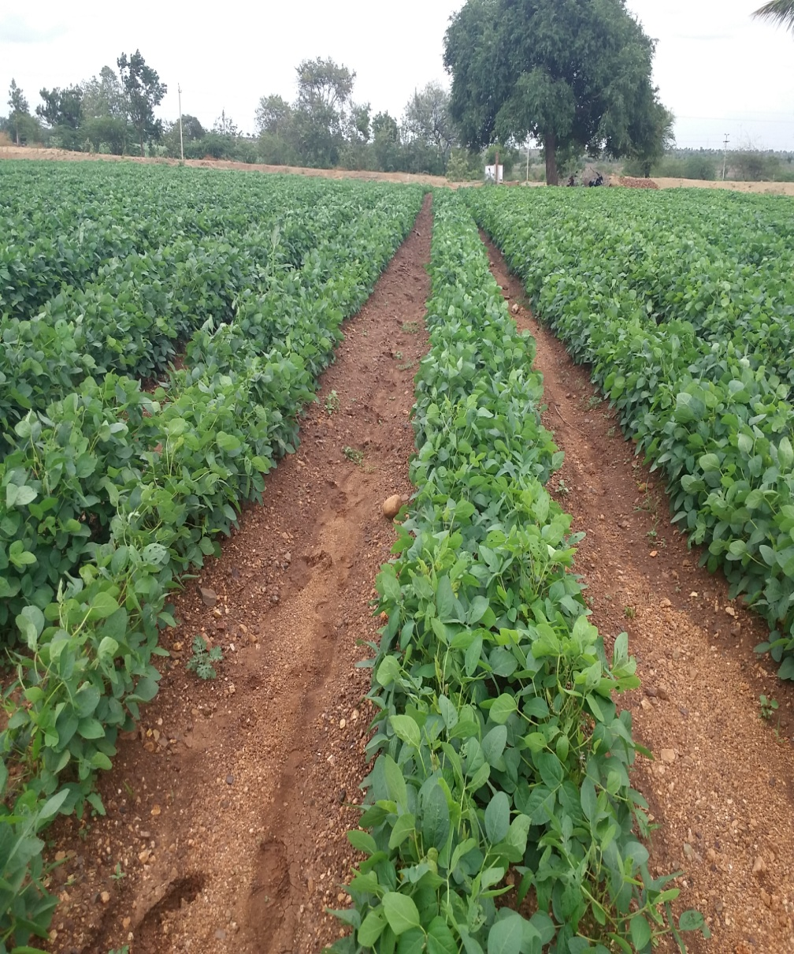
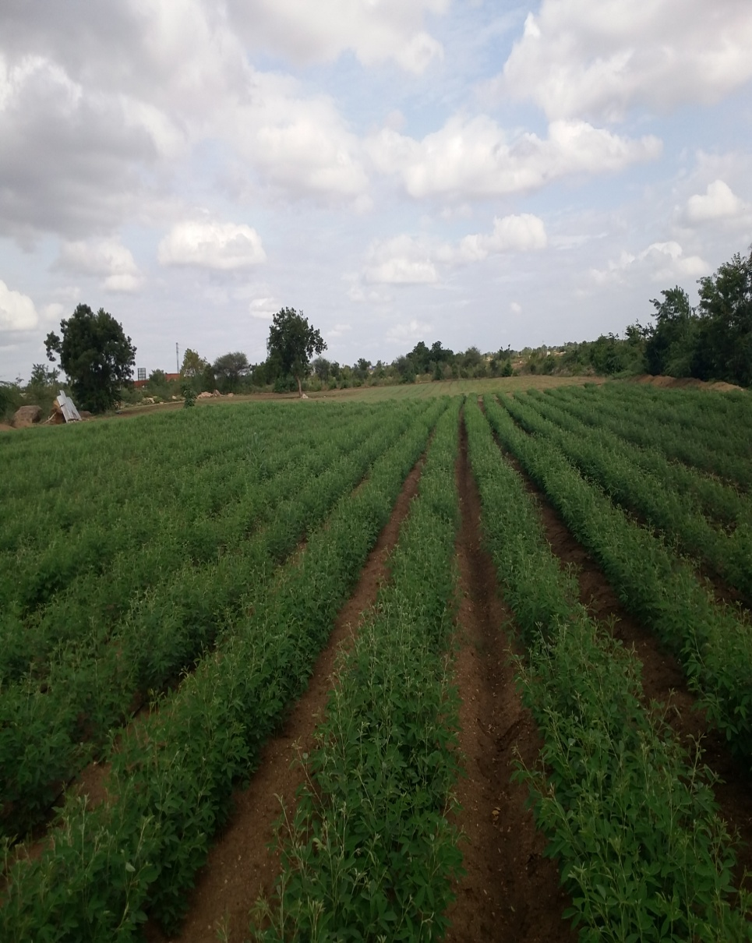

SOYA BEAN- GANGOOR RED GRAM- BELAGAL

Slide 31
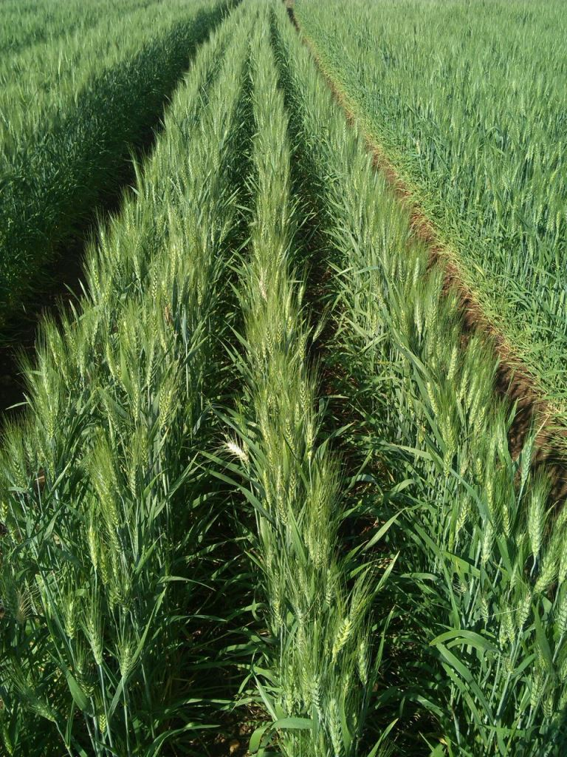
Agri- Linkages
    Rallies India Limited
    Ken Agritech Pvt Ltd
    Vishaal Natural Food Products
    Ecovinal International Pvt Ltd
    Global Green group
    Marcatus QED Inc.
    Indo Spanish
    Reitzel India
    Koeleman India Pvt Ltd
    Exotic
    IFG India
    Neo Foods
    Blossom Shower agro
    Bharati Associates
    Green Agro Pack Pvt Ltd
    The firms will get tied up with the agencies and marketing will be taken up by the agro processing units

Slide 32
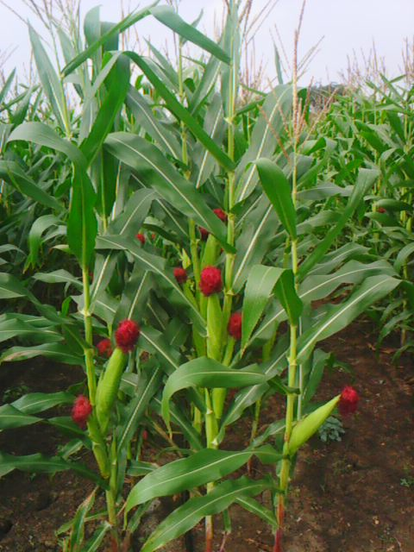
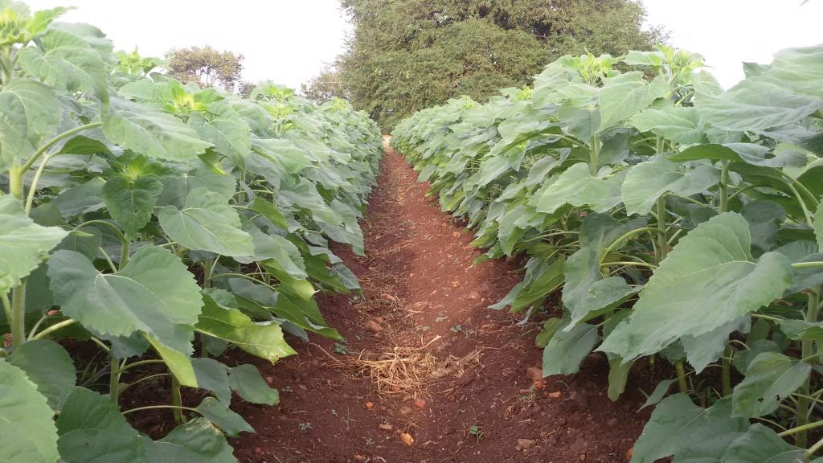
Corpus fund
Corpus Fund is the Capital generated for the continued sustenance of an Water User organization. Options considered are;
Corpus Fund Considering with Electricity and Lateral Replacement
Corpus Fund Considering without Electricity and Lateral Replacement
Corpus Fund Considering with Electricity and without Lateral Replacement
Corpus Fund Considering without Electricity and without Lateral Replacement
Components considered for corpus generation
I-Stage Electricity Charges
II-Stage Electricity Charges
Electricity charges for DRIP Operation
WUA Manpower
System Operation and maintenance charges
Tools and spare parts charges
Lateral replacement charges

Slide 33
Corpus Fund
Detailed Showing the Corpus fund calculation considering Without Electricity, with Electricity, Lateral Replacement without Electricity and Lateral Replacement with Electricity For 15 years positive corpus fund
Sl No | Options Considered | Rate of Demand in Rs / Crop / Acre
1 | Corpus Fund Considering with Electricity and Lateral Replacement | 1331.00
2 | Corpus Fund Considering without Electricity and Lateral Replacement | 1120.00
3 | Corpus Fund Considering with Electricity and without Lateral Replacement | 280.00
4 | Corpus Fund Considering without Electricity and without Lateral Replacement | 25.00
Collecting Rs1331.00 /crop/Acre will Generate a corpus fund of Rs 8928.00 Lakhs after 5 years..

Slide 34
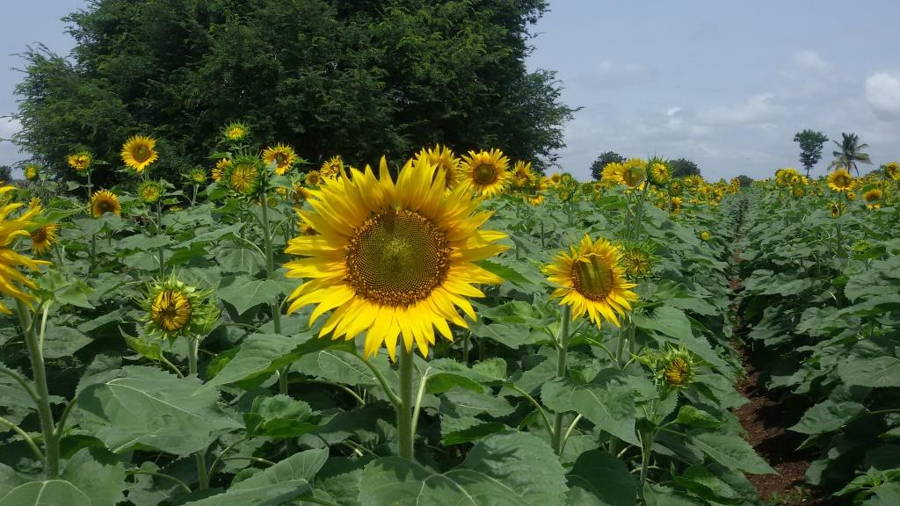
Thank you

